Slide 1

ALY 6000​ Module 4 Project
Data Analytics Job Report
Sunil Raj THOTA NUID: 001099670

Slide 2









Overview of Data Analyst​
Data Collection
Data Inspection
Data Analysis
Data Teams & Stakeholders
Data Reporting
Data Visualization
Databases and Systems
Cloud Computing
1 https://www.dataquest.io/blog/career-guide-find-data-science-jobs/
2 https://www.careerexplorer.com/careers/data-analyst/salary/

Slide 3














Skills & Tools of Data Analyst​
Technical
Non - Technical
SQL Python R
Business Acumen Critical Thinking
MS Excel Tableau SAS
Presentation Skills
AWS Machine Learning Hadoop
Research Communication Skills
3 https://www.dataquest.io/blog/data-analyst-skills/
4 https://hackr.io/blog/top-data-analyst-skills

Slide 4
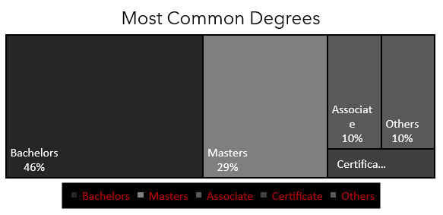
Market Analysis of Data Analyst​
5 https://towardsdatascience.com/6-key-skills-that-data-analysts-need-to-master-df1d82257b9
6 https://www.payscale.com/research/US/Job=Data_Analyst/Salary

Slide 5
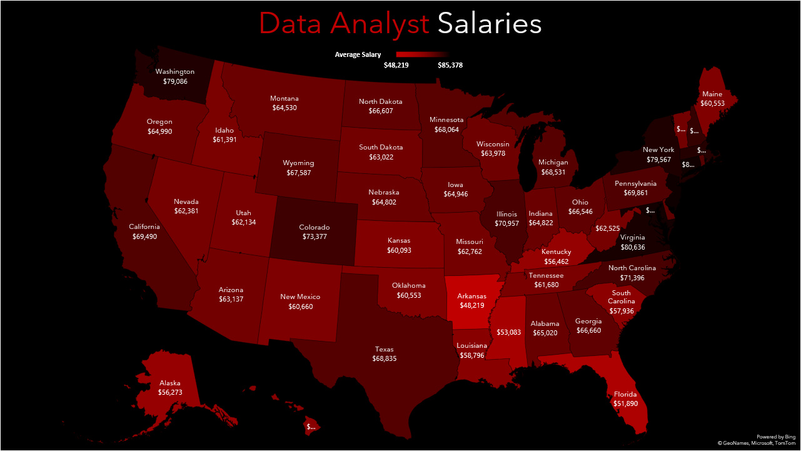

Slide 6
Future Scope of Data Analyst​
Over the last few years, data is aiding organizations, companies, and institutions make more up-to-date decisions and unveil great products & services
The global big data analytics market in 2019 is USD 40 billion and it is expected to grow at a to USD 125 billion by the year 2028
More and more data flowing from various industries like healthcare, finance, banking, transportation, IoT, smart devices, and many more…
Expected to connect, fetch, and interact with more than 100 billion devices around the world by 2024. Just imagine the amount of data is being cultivated by humans in all ways
Conclusion
The use of statistics and visualization in the fields of Data Analytics and its related networks are unprecedently becoming the go to word for all the businesses and companies.
These charts helps a person to understand better and clear about the insights drawn from the data Excel and R are one of basic building blocks to start with and also these tools are in high in demand

